Slide 1
Trade Finance Pitch
Trade Finance Product and Sales

Slide 2
Trade Finance Product Suite
Import
NON
FUNDED
Export
L/C issuance
Gtee Issuance & reissuance
Inward Collection
documents
FUNDED
Payable Financing
Avalization
TRADE FINANCE
PRODUCTS
Assignment of
Sales Proceeds
Confirmation of L/C
Risk Participation/
Trade Syndication
Outward Collection documents

Slide 3

Letter of Credit(LC’s)
Letter of Credit is an undertaking by issuing bank to provide specific payment to Beneficiary, subject to receipt of compliant documents, as requested under the LC
SIGHT & USANCE L/C
TRANSFERABLE L/C
ISSUE L/C’s
BACK-TO-BACK L/C
REVOLVING L/C
Cash LC
Cash LC
Murabaha LC
Murabaha LC
Wakala
Murabaha LC
ADVICE
&
CONFIRM L/C’s
FINANCING AGAINST
LC’s
Ability to mitigate bank risk by confirming LC’s issued by challenging banks / countries
Support financing requirement under Export LC’s through assignment of LC acceptance proceeds

Slide 4
Bank Guarantee / SBLC (Gtee’s)
Bank Guarantee is an instrument issued in which the Bank agrees to stand guarantee against either non -performance/payment obligation of a party. The bank will pay the guarantee amount to the beneficiary of the guarantee, upon receipt of a valid claim from the beneficiary.
Bid Bond
Performance Bond
Advance Payment Bond
Financial Gtee
Retention or Maintenance Bond
Standby LC
Counter Guarantee
AJMAN BANK rating BBB+
Well accepted by Govt entities
Branches across UAE
Highly skilled team

Slide 5
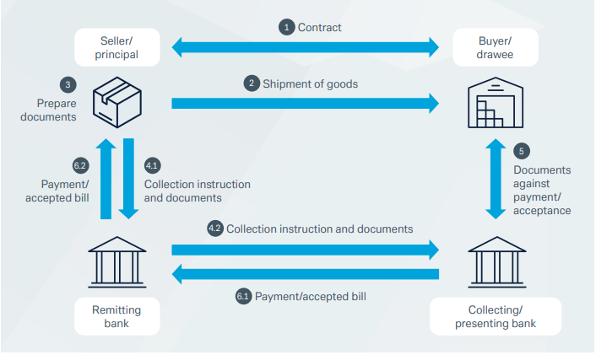
Collection Documents
Its one of the means of payment in settlement for goods / services , wherein the seller (exporter) ships goods to the buyer (importer) and sends the documents from its bank to a bank in the importer’s country to be delivered to the importer against payment, or acceptance of a bill of exchange due at a future date or free of payment
Documents Against Payment
Documents Against Acceptance
Ajman bank can support in Inward & Outward Bill collections, wherein it can act as either Collecting bank (Inward Bill) or Remitting bank ( Outward Bill)
At the request of our client, Ajman bank can also “Avalize”, accepted bill of exchange to create bank obligation.

Slide 6
Payables Financing
Provide Working capital finance to import/locally procure Raw material. Usually, Short term in Nature < 1 year
LC Murabaha - For LC retirement
Collections Murabaha - Against Collection docs
Open Account Financing – For Supplier payment
Advance Payment – Against Performa Invoice
Revolving Credit Facility
Subject to availability of credit limits
Payment directly to Suppliers
Can be in AED or other Currencies

Slide 7
Assignment of Sales Proceeds
Provide financing against Assignment of Proceeds (AOP) under various Instruments
Subject to banks approved list of drawers
Post Dated
Cheques
Financing of PDC lodged with Ajman bank
LC acceptance
/ Avalized Bill
Outward Collection bill
Funds against Bills sent to collecting bank
Sales Invoice
Financing against Sales Invoices
Fund Post Acceptance/ Avalization from Bank
Based on limits on the bank issuing the LC acceptance
AOP
Subject to approved list of drawee & documents being routed through Ajman Bank
Subject to banks approved list of buyers

Slide 8
Contact Details
Ashish Madan
Head of GTB- Wholesale Banking
Ashish.Madan@Ajmanbank.ae
06-7018278
Mohit Daswani
Senior Manager Trade Product & Sales
Mohit.Daswani@Ajmanbank.ae
06-7018698
Prakash Kannappan
Manager Trade Projects & Sales
Prakash.kannappan@Ajmanbank.ae
06-7018834

